Slide 1
Institute of Linguistics RAS MOSCOW 26 May 2021
СУДЬБА ЯЗЫКОВОГО НАСЛЕДИЯ:
ПЕРЕДАНО МЛАДШИМ ПОКОЛЕНИЯМ
ИЛИ УТРАЧЕНО?
коллоквиум
Где нам выучить наш родной язык?
Ana Kondic, DLCE Max Planck Jena, Germany kondic@shh.mpg.de

Slide 2
My experience in documentation of indigenous languages of Latin America
South Eastern Huastec (Mayan), Veracruz, Mexico, 12 thousand speakers (field work from 2006)
Tsotsil de San Isidro (Mayan), Chiapas, Mexico, 300 speakers (from 2013)
Tsesungun (Mapudungan), Patagonia, Chile;
25 speakers (2015)
Mixe (Mixe-Zoquean), Oaxaca, Mexico (2018-2020)

Slide 3
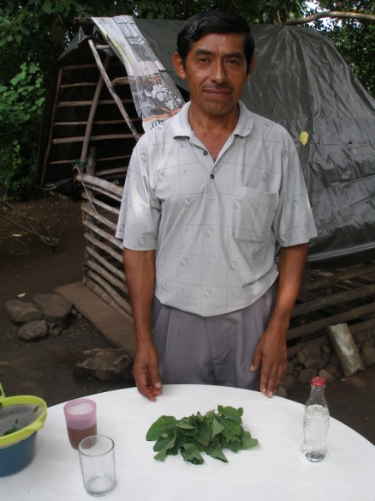
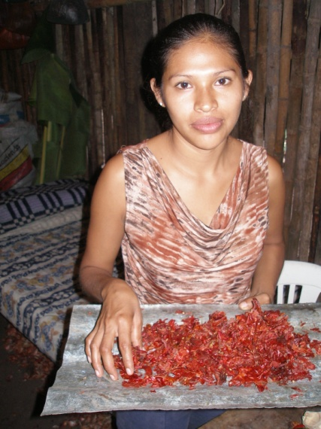
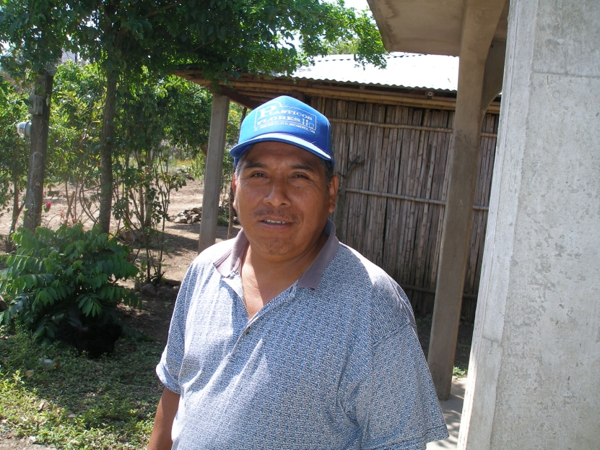
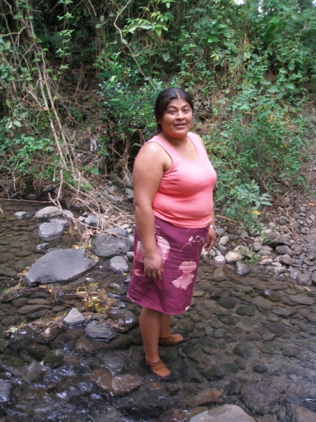
I South Eastern Huastec (Mayan)
ISO code: ISO639-3 hus
Glottolog: huas 1242
Endonym: Teenek
Spoken in: Veracruz, Mexico
No speakers: about 12 000
Field work: from 2006 in the village of
San Francisco Chontla.

Slide 4
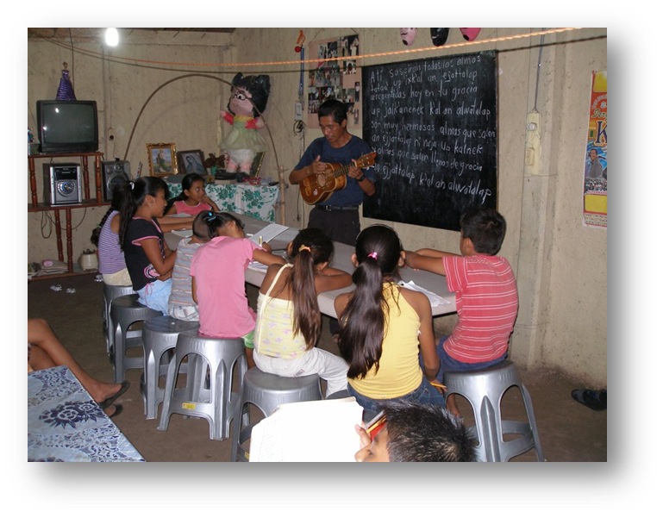
Language activities among SE Huastec
Language not transmitted to children (Spanish only).
SE Huastec speakers 50 y.o. and above.
Not taught in schools, no courses for adults, no media.
Orthography available; I produced teaching materials.
Local musician Narcizo
de la Cruz teaches groups of
children his songs in Huastec.
Community interested in
the ‘linguistic nest’.

Slide 5
II Tsotsil de San Isidro (Mayan), Chiapas, Mexico

Slide 6
ISO code: 639-3 tzo
Glottolog code: tzot 1259
Alt. name: Bats’i K’op
Language family: Mayan
Total no of speakers: 235,000 (2000 INALI)
San Isidro Libertad: about 300
Endangerment status: 6b (threatened)
Notes:
Pod ugrozoj izcheznovenia

Slide 7
Language activities among Tsotsil of San Isidro
Very proud of their identity, highly value their language – an autonomous community.
Tsotsil of SI is the first language to all children.
Primary school in Tsotsil, secondary bilingual.
I produced a book of teaching materials.
All extracurricular activities in Tsotsil.
Some publications, some courses and some radio program in neighbouring varieties of Tsotsil.

Slide 8
III Tsesungun, Patagonia, Chile

Slide 9
Tsesungun (Mapudungan), Patagonia, Chile
Huilliche/Veliche/Tsesungun ISO 639-3 huh
Mapudungan (isolate): Picunche (north), Moluche (center), Pehuenche (east), Huil./Tsesungun (south).
Tsesungun: Tse (che) people, sungun language , “language of the people”
moribund: cca 25 fluent speakers (10-15 Osorno, 5 Chiloé, 2 Huapi island) out of about 100 thousand ethnic community.
highest concentration of Huilliche people: Province of Osorno, San Juan de la Costa community.

Slide 10
Tsesungun language activities
Not passed to children, not used for communication.
Fluent speakers are elderly; 2 young men learned from their grandmothers; several semi-speakers.
Taught in some primary schools (teachers semi-speakers, except Hugo Antipani from Chiloé).
I produced a book of teaching materials for them.
Some language and culture courses for adults, rather popular. Orthography available. Radio program in Osorno (one hour every evening).
Interested in ‘Linguistic nest’.

Slide 11
Hugo Antipani Archipelago Chiloe
Teacher of Tsesungun language and culture
Writes in Tsesungun and translates
Musician, poet
Several narratives, a song, a Tsesungun dictionary of Chiloe variety for my project.

Slide 12
Three generations of Huilliche in Pualhue (Osorno): Viviana (full speaker), Iris (semi-speaker), Mari Antv (non-speaker)

Slide 13
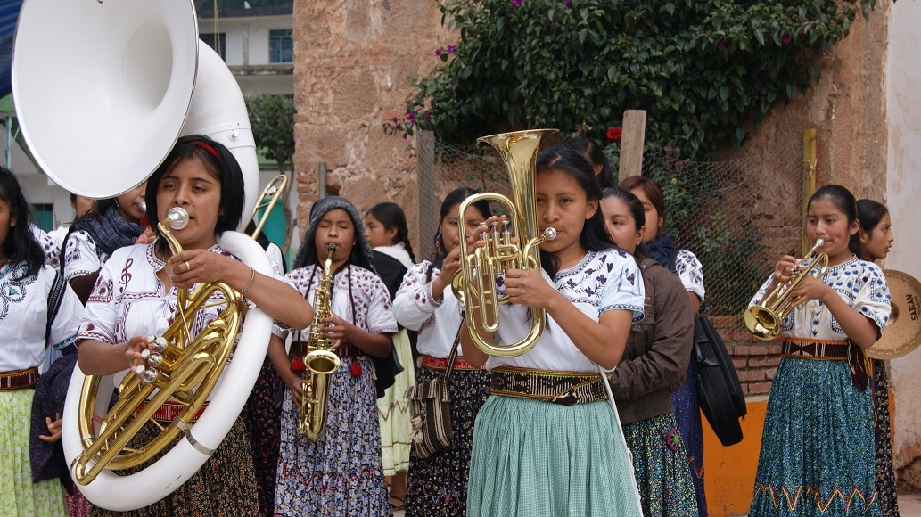
IV Mixe of Sierra Norte, Oaxaca, Mexico
SOURCE: https://etniasdelmundo.com/c-mexico/mixes/

Slide 14
The state of Oaxaca, Mexico

Slide 15
Mixe (Mixe-Zoquean group)
MIXE (endonym: Ayuuk)
Endangered. 17 varieties (Wichmann 2008)
Ayutla Mixe Grammar (Romero 2008), articles by Jany and Zavala; Wichmann (typological and historical approach). Majority of the varieties un(der)described and undocumented.
Ocotepec (Totontepec), North Highland Mixe (5500 speakers) ISO 639-3 mto, Glottolog toto 1305
Cotzocón and Puxmetacan, North Midland Mixe, totally undescribed (13000 sp.) ISO 639-3 neq, Glott. north 2939
Tlahuitoltepec, South Highland Mixe (16000 speakers) ISO 639-3 mxp, Glottolog tlah 1239.

Slide 16
Language activities among Mixe
Ocotepec and Cotzocon among the most remote Mixe municipalities– vast majority of children learn the language at home. In Tlahuitoltepec, some children speak only Spanish.
The language is taught in some schools: if the teacher is local, he teaches in Mixe, if not – in Spanish.
I produced teaching materials for the above mentioned three Mixe varieties.
Courses of Mixe orthography for adults in some communities and in Oaxaca. Some authors write and publish in Mixe (especially in Tlahuitoltepec and Ayutla). Radio program in the variety of Tlahuitoltepec.

Slide 17
Engracia, Mixe de Ocotepec (Totontepec)
‘Promotora cultural’ (Eng: Cultural Promotor) with Mixe (courses, Mixe theater, texts, published two books in Mixe: Mixe gastronomy, Mixe arts and crafts). Coordinator of my project.

Slide 18
Language transmission in these communities: a summary
More a community is remote, more it sticks to their traditions - the language transmitted.
Ways of language transmission/acquisition:
[1] at home, in the familly
[2] in school environment
[3] extracurricular activities
[4] project “the linguistic nest”
(recreates family setting)

Slide 19
Language transmission: a summary, cont.
WHERE | HUASTEC (Maya) Mexico | TSOTSIL (Maya) Mexico | TSESUNGUN (Mapudun-gan) Chile | MIXE (Mixe-Zoquean) Mexico
at home | no (cca 50 years) | yes | no (long ago) | yes
school | no | yes | sometimes | sometimes
elsewhere | Narcizo’s music groups | yes | some courses | some courses
ling. nest | Interested – planning | N/A | interested - planning | N/A

Slide 20
Tyoos këjuyëp! Thank you! Mixe
SOURCE: https://etniasdelmundo.com/c-mexico/mixes/

